Slide 1


Introduction to Circuits Analysis
by Andrew G. Bell
abell118@ivytech.edu
(260) 481-2288
Lecture 6

Slide 2
CHAPTER 6
Series-Parallel Circuits

Slide 3
Series-Parallel Circuits
A series-parallel circuit contains both series and parallel connected components.
There are both in-line series current paths and branch-type parallel current paths.

Slide 4
Series-Parallel Circuits (cont.)
These circuits come in many different formats.
The key to understanding them is the ability to recognize the series elements and parallel elements.

Slide 5
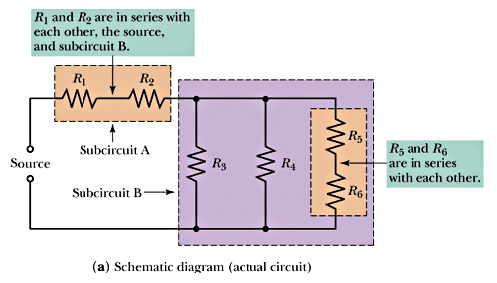
Recognizing Series Components

Slide 6
Analysis
Analysis of the circuit also requires one to recognize the various paths for current flow.
The ability to recognize the points where current branches out and where current converges (sums) is vital.

Slide 7
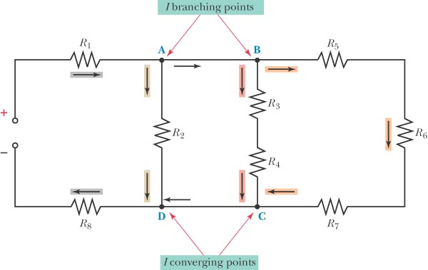
Example

Slide 8
Total Resistance
One of the common approaches is called “Outside toward the Source.”
To implement this method, begin farthest from the source and work toward the source.

Slide 9
Equivalent Resistance
The analysis of the circuit uses equivalent resistance as circuit reductions are performed.
For instance, if a 6-kΩ and a 3-kΩ resistor are in parallel, their equivalent series resistance is 2 kΩ.

Slide 10
Example
Observe how the concept of total resistance and equivalent circuits can be used in a complex arrangement.
A reduce-and-redraw approach helps simplify circuit analysis.

Slide 11
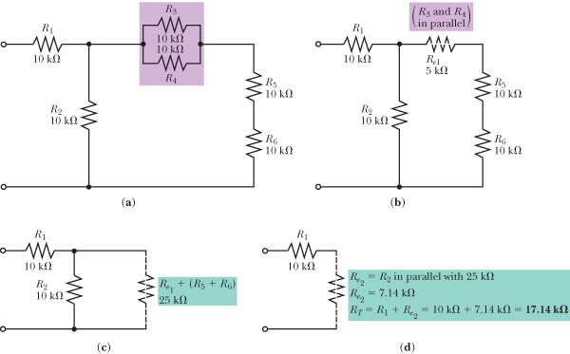
Example

Slide 12
Current in a Series-Parallel Circuit
The analysis of current in this type of circuit is a fundamental step.
Kirchhoff’s current law must be followed to see how current divides and sums together.

Slide 13
Circuit Analysis Tools
The circuit tools used to determine circuit parameters include:
Ohm’s law
Watt’s law
KCL and KVL
Voltage divider rule
Current divider rule

Slide 14
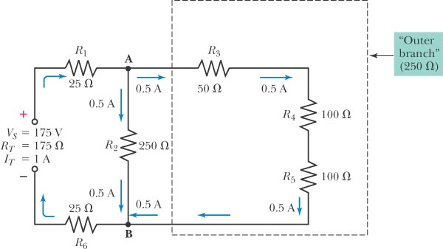
Solving for Current

Slide 15
Voltage in a Series-Parallel Circuit
Voltage distribution throughout the circuit follows the laws appropriate to series and parallel connections.
Apply the rules and laws already learned about series and parallel components.

Slide 16
Power in a Series-Parallel Circuit
Analysis of power distribution in the circuit follows the same rules for pure series and pure parallel circuits.
Total power dissipation is the sum of all the individual power dissipations by the circuit components.
Individual power dissipations are calculated using Watt’s law.

Slide 17
Effects of Opens
An open will cause the total resistance to decrease.
An open will cause the total current to increase.

Slide 18
Current Measurements
Measuring current in the parallel portion will indicate if an open exists.
Measuring voltage in the series portion will indicate opens via the absence of voltage drops.

Slide 19
Effects of Shorts
A short will cause the total resistance to decrease.
A short will cause the total current to increase.

Slide 20
Voltage Measurements
Measuring voltage in the parallel portion will indicate if a short exists.
Measuring current in the series portion will indicate shorts.

Slide 21
Loaded Voltage Dividers
The voltage divider is a common series-parallel circuit.
As loads are placed on the circuit, the analysis becomes a bit more difficult.

Slide 22
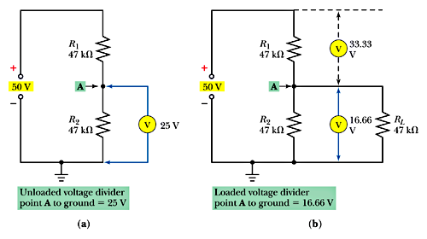
An Example

Slide 23
The Wheatstone Bridge
This circuit is a series-parallel circuit that is very popular in controls and industrial applications.
There are two states for the bridge:
Balanced Unbalanced
V_{A} = V_{B} V_{A} ≠ V_{B}

Slide 24
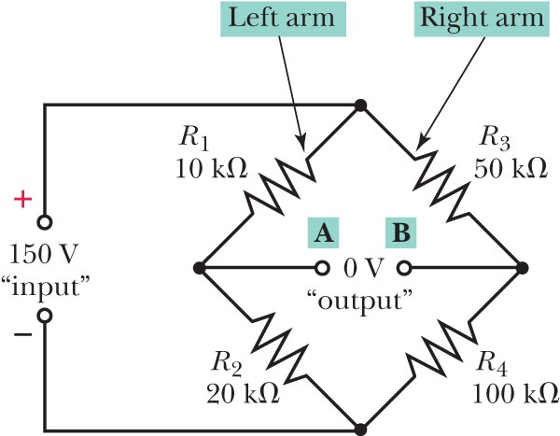
The Wheatstone Bridge (cont.)

Slide 25
Balanced Bridges

Slide 26
The Murray Loop
The Murray loop is a special type of Wheatstone bridge used to locate underground conductors.

Slide 27
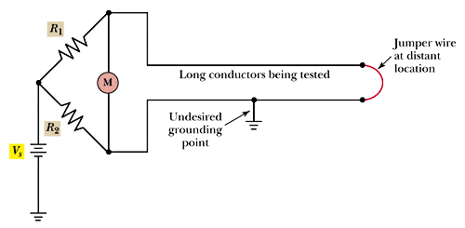
The Murray Loop (cont.)

